Slide 1

BANK ACCOUNT MANAGEMENT SYSTEM
DBMS Project
REVIEW 2
DEPARTMENT: COMPUTER SCIENCE AND ENGINEERING
YEAR: II B.TECH
SUBJECT: DATABASE MANAGEMENT SYSTEMS
FACULTY: [VYDEHI MAM]
PRESENTED BY:
T.Venkata Ramu-25B11CS957
T.Vijay Manikanta-25B11CS951
01-10-2026
DBMS
1

Slide 2
PROBLEM STATEMENT:
Managing customer and banking records in an organized way is challenging.
Maintaining accurate account and transaction details is important.
Handling branch, employee, and loan information requires proper organization.
Unorganized records can cause data redundancy and inconsistency.
A centralized database is needed for quick and reliable access to banking information
PROPOSED SOLUTION:
Develop a Bank Account Management System using DBMS and SQL.
Store customer, branch, employee, account, transaction, and loan details in related tables.
Use Primary Keys and Foreign Keys to establish relationships between tables.
Apply database constraints to maintain data accuracy and integrity.
01-10-2026
DBMS
2

Slide 3
WHY IS THE SYSTEM NEEDED?
To manage banking information in a structured and centralized database.
To reduce data redundancy and inconsistency in customer and account records.
To maintain accurate account and transaction details.
To efficiently manage customers, accounts, branches, employees, and loans.
To provide quick access to required banking information.
To maintain data integrity and proper relationships between different banking records.
01-10-2026
DBMS
3

Slide 4
OBJECTIVES:
The main objectives of the Bank account Management System are:
To develop a centralized database for managing banking information.
To maintain accurate records of customers and their accounts.
To manage deposits, withdrawals, and other transactions efficiently.
To maintain details of branches, bank employees, and loans.
To establish proper relationships between different banking records.
To ensure data accuracy, consistency, and integrity using data
To provide what of banking information using SQL queries.
01-10-2026
DBMS
4

Slide 5
FUNCTIONAL REQUIREMENTS:
The system should be able to:
Add, update, delete, and view customer details.
Create and manage customer accounts, including savings and checking accounts.
Store and manage branch details such as branch name, address, and IFSC code.
Maintain employee details and their assigned branch.
Record deposits, withdrawals, transfers, and other account transactions.
Store and manage loan details, including loan type, amount, interest rate, and status.
Maintain and display the current balance of each account.
Manage specific details of savings and checking accounts.
01-10-2026
DBMS
5

Slide 6
NON-FUNCTIONAL REQUIREMENTS:
The system should provide:
Security – Protect customer, account, loan, and transaction data from unauthorized access.
Performance – Retrieve records and process database operations quickly.
Reliability – Ensure transactions and database operations are performed accurately and consistently.
Data Integrity – Maintain accurate relationships between Customer, Account, Loan, Transaction, Branch, and Employee entities.
Usability – Provide a simple and easy-to-use system for managing banking information.
Scalability – Support an increasing number of customers, accounts, employees, loans, and transactions.
Availability – Ensure the database is accessible whenever banking operations are required.
Maintainability – Make the database structure easy to modify and maintain.
Backup and Recovery – Provide mechanisms to prevent permanent loss of banking data.
Privacy – Keep personal and financial information of customers confidential
01-10-2026
DBMS
6

Slide 7
END USERS
.
ADMINISTRATOR
• Manages the complete bank account management system.
• Adds, updates, and manages customer information.
• Manages bank accounts and account types.
• Monitors transactions, loans, branches, and employees.
2. BANK EMPLOYEE
• Registers and manages customer details.
• Creates and updates customer accounts.
• Records deposits, withdrawals, and fund transfers.
• Manages loan and transaction information.
.
3. CUSTOMER
• Provides personal details for account registration.
• Views account and balance information.
• Performs deposits, withdrawals, and fund transfers.
01-10-2026
DBMS
7

Slide 8
ER DESIGN:
The Entity-Relationship (ER) model represents the structure of the Bank account Management System.
It identifies:
Entities – Objects involved in the system.
Attributes – Properties that describe each entity.
Primary Keys – Uniquely identify each record.
Relationships – Show how entities are connected.
Cardinality – Defines how many records of one entity can be associated with another entity.
MAIN ENTITIES:
Customer
Branch
Account
Transaction
Loan
Bank_Employee
01-10-2026
DBMS
8

Slide 9
Entities and attributes
CUSTOMER → Customer_ID, Name, Date_of_Birth, Gender, Phone, Email, Address
BRANCH → Branch_ID, Branch_Name, IFSC_Code, Address, Phone
BANK_EMPLOYEE → Employee_ID, Name, Phone, Email, Role
ACCOUNT → Account_ID, Customer_ID, Branch_ID, Account_Type, Balance, Opening_Date, Status
TRANSACTION → Transaction_ID, Account_ID, Transaction_Type, Amount, Transaction_Date, Description
LOAN → Loan_ID, Customer_ID, Employee_ID, Loan_Type, Amount, Interest_Rate, Loan_Date, Status
01-10-2026
DBMS
9

Slide 10
ENTITY JUSTIFICATION:
Customer
Stores information about people who rent vehicles.
Vehicle
Stores details of vehicles available for rental.
Vehicle Type
Classifies vehicles according to their type, such as car, bike, SUV, etc.
Rental
Stores information about vehicle booking and rental periods.
Payment
Maintains payment information related to a rental.
Return
Stores details about the return of a rented vehicle.
Staff
Stores information about employees who manage rental activities.
01-10-2026
DBMS
10

Slide 11
RELATIONSHIPS:
A relationship tells us how two entities are connected to each other.
• A Customer owns one or more Accounts .
• A Branch contains one or more Accounts .
• An Account has one or more Transactions .
• A Customer applies for one or more Loans .
• A Bank Employee processes one or more Loans .
01-10-2026
DBMS
11

Slide 12
CARDINALITY:
Customer — Account
1 : M
One customer can own many accounts, while each account belongs to one customer.
Branch — Account
1 : M
One branch can have many accounts, while each account belongs to one branch.
Account — Transaction
1 : M
One account can have many transactions, while each transaction belongs to one account.
Customer — Loan
1 : M
One customer can have many loans, while each loan belongs to one customer.
Bank Employee — Loan
1 : M
One bank employee can process many loans, while each loan is processed by one bank employee
01-10-2026
DBMS
12

Slide 13
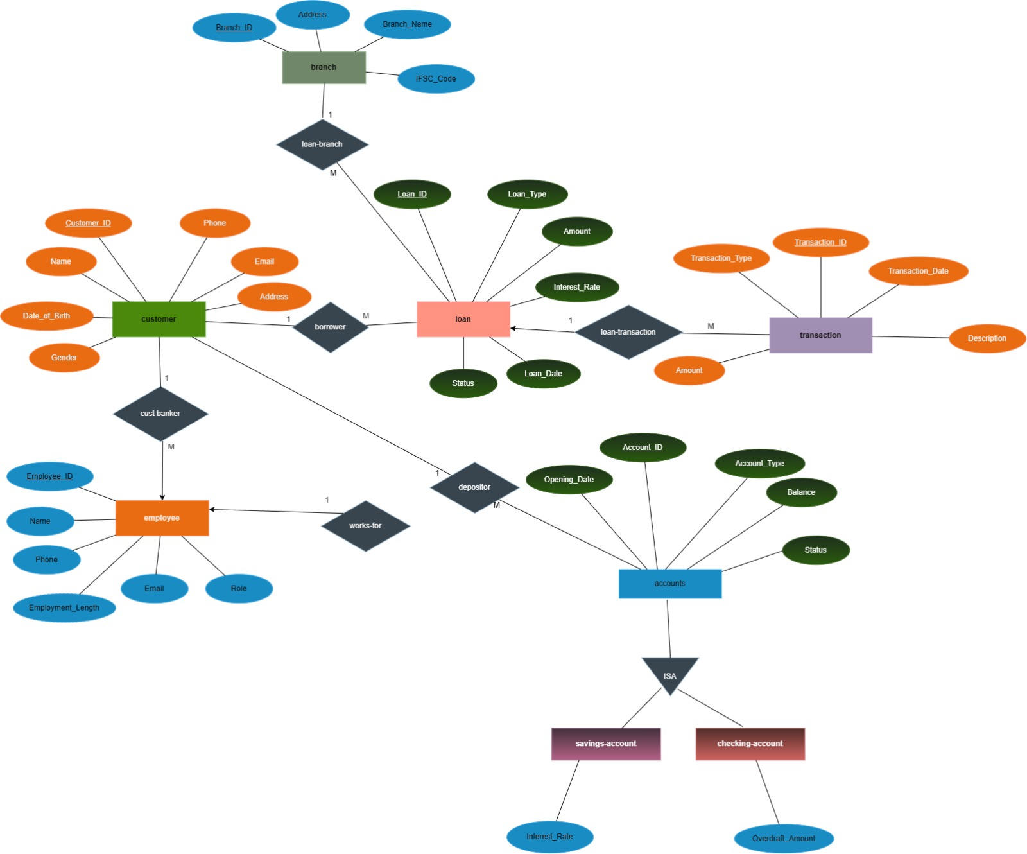
ER-DIAGRAM
01-10-2026
DBMS
13

Slide 14
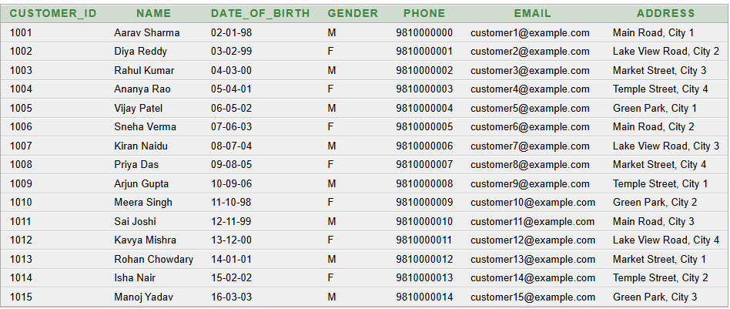
TABLES
SELECT * FROM CUSTOMER;
CUSTOMER TABLE
CREATE TABLE CUSTOMER (
Customer_ID NUMBER(6) PRIMARY KEY,
Name VARCHAR2(80) NOT NULL,
Date_of_Birth DATE NOT NULL,
Gender VARCHAR2(10) CHECK (Gender IN ('M','F','Other')),
Phone VARCHAR2(15) NOT NULL UNIQUE,
Email VARCHAR2(100) NOT NULL UNIQUE,
Address VARCHAR2(200) NOT NULL
);
01-10-2026
DBMS
14

Slide 15
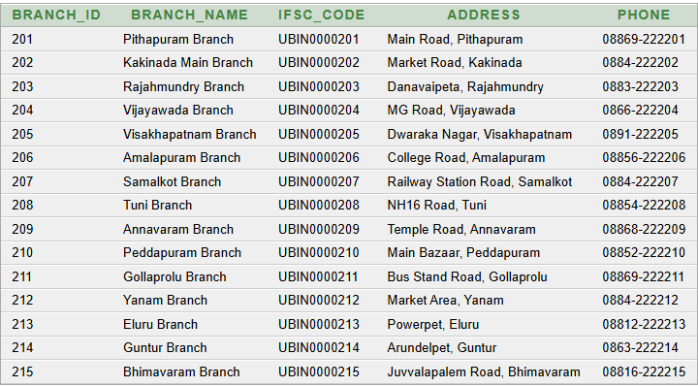
BRANCH TABLE
SELECT * FROM BRANCH;
CREATE TABLE BRANCH (
Branch_ID NUMBER(4) PRIMARY KEY,
Branch_Name VARCHAR2(100) NOT NULL,
IFSC_Code VARCHAR2(15) NOT NULL UNIQUE,
Address VARCHAR2(200) NOT NULL,
Phone VARCHAR2(20) NOT NULL
);
01-10-2026
DBMS
15

Slide 16
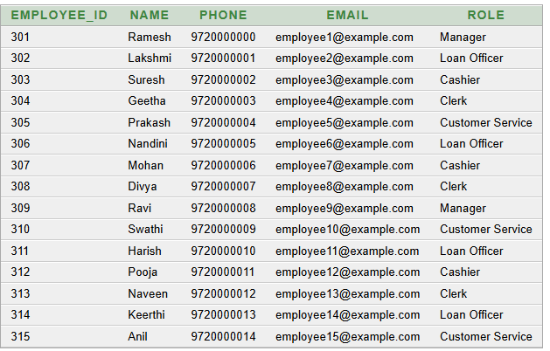
BANK _EMPLOYEE TABLE
SELECT * FROM BANK_EMPLOYEE;
CREATE TABLE BANK_EMPLOYEE (
Employee_ID NUMBER(4) PRIMARY KEY,
Name VARCHAR2(80) NOT NULL,
Phone VARCHAR2(15) NOT NULL UNIQUE,
Email VARCHAR2(100) NOT NULL UNIQUE,
Role VARCHAR2(40) NOT NULL
);
01-10-2026
DBMS
16

Slide 17
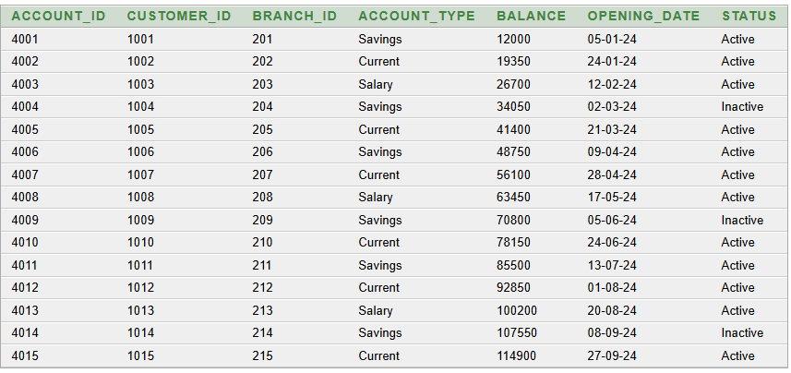
SELECT * FROM ACCOUNT;
ACCOUNT TABLE
CREATE TABLE ACCOUNT (
Account_ID NUMBER(6) PRIMARY KEY,
Customer_ID NUMBER(6) NOT NULL,
Branch_ID NUMBER(4) NOT NULL,
Account_Type VARCHAR2(20) NOT NULL
CHECK (Account_Type IN ('Savings','Current','Salary')),
Balance NUMBER(12,2) DEFAULT 0 NOT NULL
CHECK (Balance >= 0),
Opening_Date DATE NOT NULL,
Status VARCHAR2(20) DEFAULT 'Active' NOT NULL
CHECK (Status IN ('Active','Inactive','Closed')),
FOREIGN KEY (Customer_ID) REFERENCES CUSTOMER(Customer_ID),
FOREIGN KEY (Branch_ID) REFERENCES BRANCH(Branch_ID)
);
01-10-2026
DBMS
17

Slide 18
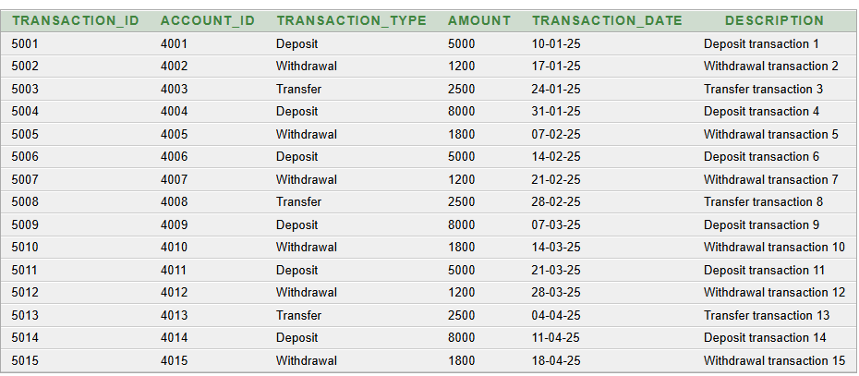
TRANSACTION TABLE
SELECT * FROM TRANSACTION;
CREATE TABLE TRANSACTION (
Transaction_ID NUMBER(6) PRIMARY KEY,
Account_ID NUMBER(6) NOT NULL,
Transaction_Type VARCHAR2(20) NOT NULL
CHECK (Transaction_Type IN ('Deposit','Withdrawal','Transfer')),
Amount NUMBER(12,2) NOT NULL CHECK (Amount > 0),
Transaction_Date DATE NOT NULL,
Description VARCHAR2(200),
FOREIGN KEY (Account_ID) REFERENCES ACCOUNT(Account_ID)
);
DBMS
01-10-2026
18

Slide 19
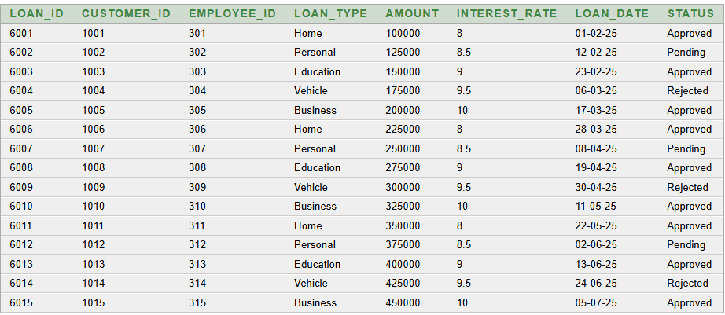
LOAN TABLE
SELECT * FROM LOAN;
CREATE TABLE LOAN (
Loan_ID NUMBER(6) PRIMARY KEY,
Customer_ID NUMBER(6) NOT NULL,
Employee_ID NUMBER(4) NOT NULL,
Loan_Type VARCHAR2(30) NOT NULL,
Amount NUMBER(12,2) NOT NULL CHECK (Amount > 0),
Interest_Rate NUMBER(5,2) NOT NULL
CHECK (Interest_Rate > 0 AND Interest_Rate <= 30),
Loan_Date DATE NOT NULL,
Status VARCHAR2(20) NOT NULL
CHECK (Status IN ('Approved','Pending','Rejected')),
FOREIGN KEY (Customer_ID) REFERENCES CUSTOMER(Customer_ID),
FOREIGN KEY (Employee_ID) REFERENCES BANK_EMPLOYEE(Employee_ID)
);
01-10-2026
DBMS
19

Slide 20
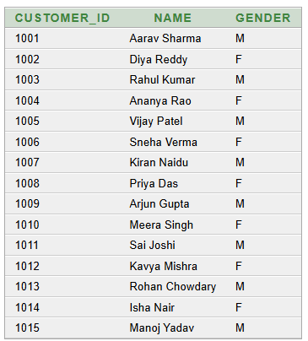
QUERIES
Basic Query 1 — Display all customers
SELECT Customer_ID, Name, Gender
FROM CUSTOMER
ORDER BY Customer_ID;
01-10-2026
DBMS
20

Slide 21
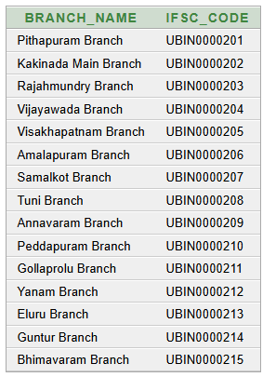
Basic Query 2___Display branch names and IFSC codes
SELECT Branch_Name, IFSC_Code
FROM BRANCH
ORDER BY Branch_ID;
01-10-2026
DBMS
21

Slide 22
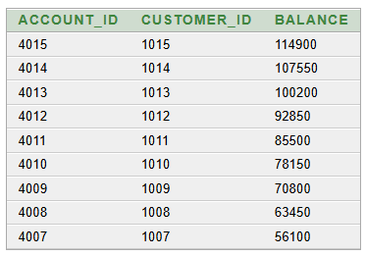
Basic Query 3 — Accounts with balance greater than 50000
SELECT Account_ID, Customer_ID, Balance
FROM ACCOUNT
WHERE Balance > 50000
ORDER BY Balance DESC;
01-10-2026
DBMS
22

Slide 23
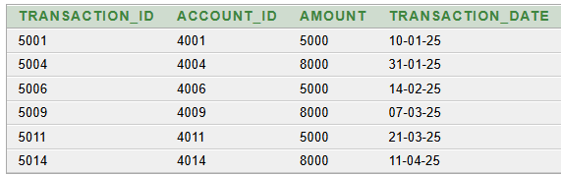
Query 4 —Display deposit transactions
SELECT Transaction_ID, Account_ID, Amount, Transaction_Date
FROM TRANSACTION
WHERE Transaction_Type = 'Deposit'
ORDER BY Transaction_ID;
01-10-2026
DBMS
23

Slide 24
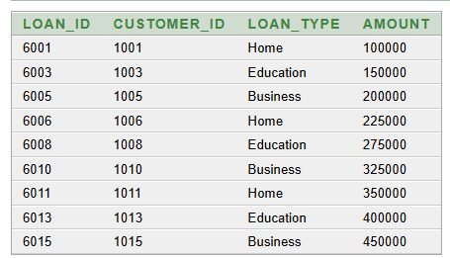
Query 5__Display approved loans
SELECT Loan_ID, Customer_ID, Loan_Type, Amount
FROM LOAN
WHERE Status = 'Approved'
ORDER BY Loan_ID;
01-10-2026
DBMS
24

Slide 25
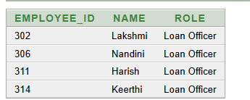
Query 6—Display Loan Officers
SELECT Employee_ID, Name, Role
FROM BANK_EMPLOYEE
WHERE Role = 'Loan Officer'
ORDER BY Employee_ID;
01-10-2026
DBMS
25

Slide 26

Query 7 — Count customers by gender
SELECT Gender, COUNT(*) AS Customer_Count
FROM CUSTOMER
GROUP BY Gender
ORDER BY Gender;
01-10-2026
DBMS
26

Slide 27
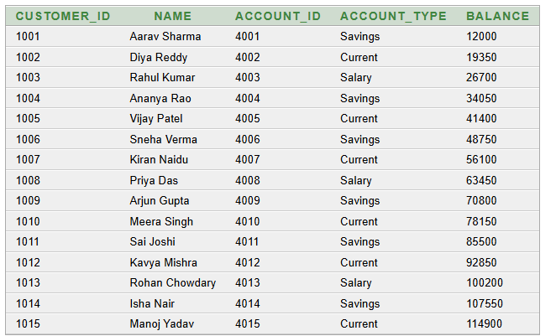
Advanced Query 1—Customer and account details
SELECT c.Customer_ID, c.Name, a.Account_ID,
a.Account_Type, a.Balance
FROM CUSTOMER c
JOIN ACCOUNT a ON a.Customer_ID = c.Customer_ID
ORDER BY c.Customer_ID;
01-10-2026
DBMS
27

Slide 28
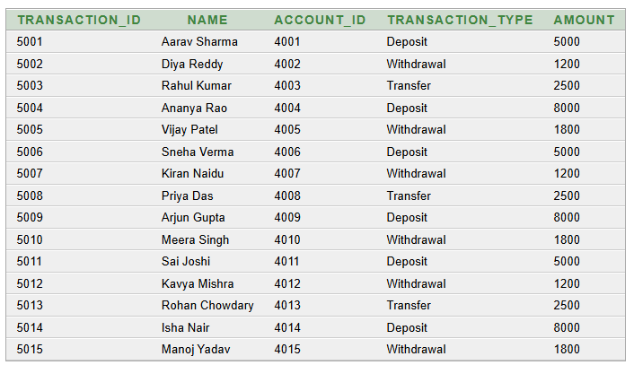
Advanced Query 2__Transactions with customer and account details
SELECT t.Transaction_ID, c.Name, a.Account_ID,
t.Transaction_Type, t.Amount
FROM TRANSACTION t
JOIN ACCOUNT a ON t.Account_ID = a.Account_ID
JOIN CUSTOMER c ON a.Customer_ID = c.Customer_ID
ORDER BY t.Transaction_ID;

Slide 29
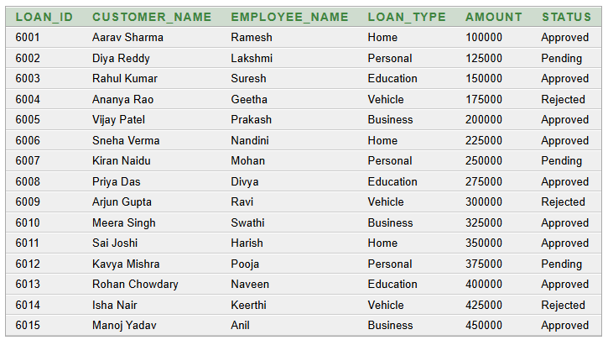
Advanced Query 3__Loans with customer and employee names
SELECT l.Loan_ID, c.Name AS Customer_Name,
e.Name AS Employee_Name, l.Loan_Type,
l.Amount, l.Status
FROM LOAN l
JOIN CUSTOMER c ON l.Customer_ID = c.Customer_ID
JOIN BANK_EMPLOYEE e ON l.Employee_ID = e.Employee_ID
ORDER BY l.Loan_ID;

Slide 30
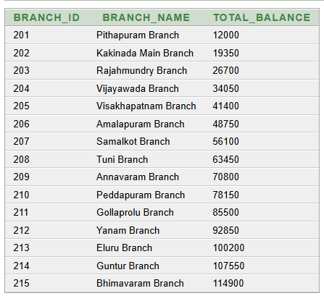
Advanced Query 4__ Total account balance by branch
SELECT b.Branch_ID, b.Branch_Name,
SUM(a.Balance) AS Total_Balance
FROM BRANCH b
JOIN ACCOUNT a ON a.Branch_ID = b.Branch_ID
GROUP BY b.Branch_ID, b.Branch_Name
ORDER BY b.Branch_ID;

Slide 31
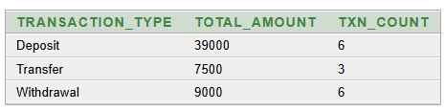
Advanced Query 5__ Transaction totals by type
SELECT Transaction_Type,
SUM(Amount) AS Total_Amount,
COUNT(*) AS Txn_Count
FROM TRANSACTION
GROUP BY Transaction_Type
ORDER BY Transaction_Type;

Slide 32
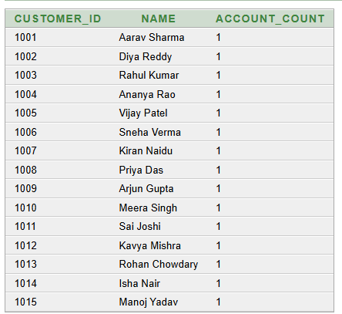
Advanced Query 6__ Customers with their Account Count
SELECT c.Customer_ID,
c.Name,
COUNT(a.Account_ID) AS Account_Count
FROM CUSTOMER c
JOIN ACCOUNT a
ON c.Customer_ID = a.Customer_ID
GROUP BY c.Customer_ID, c.Name
ORDER BY c.Customer_ID;

Slide 33
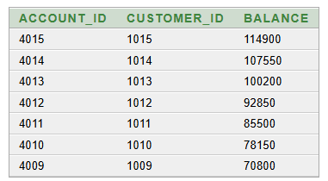
Advanced Query 7__ Accounts with balance above average
SELECT Account_ID, Customer_ID, Balance
FROM ACCOUNT
WHERE Balance > (SELECT AVG(Balance) FROM ACCOUNT)
ORDER BY Balance DESC;

Slide 34

Advanced Query 8__
Highest-balance account(s)
SELECT Account_ID, Customer_ID, Balance
FROM ACCOUNT
WHERE Balance = (SELECT MAX(Balance) FROM ACCOUNT);

Slide 35
NORMALISATION
FIRST NORMAL FORM — 1NF
The Bank Account Management System satisfies 1NF because:
• All attributes contain single and atomic values.
• There are no repeating groups or multivalued attributes.
• Each account is uniquely identified by Account_ID.
• Customer and branch information is stored in individual fields.
• Each account record is stored as a separate row.
• The relation is organized into rows and columns.
BEFORE THE 1NF
AFTER 1NF
01-10-2026
DBMS
35

Slide 36
1NF--(NORMAL FORM)
FIRST
(Account_ID, Transaction_ID, Customer_ID, Customer_Name,
Customer_Phone, Branch_ID, Branch_Name, Account_Type,
Balance, Opening_Date, Account_Status, Amount)
Functional Dependencies
ACCOUNT_ID → CUSTOMER_ID
ACCOUNT_ID → CUSTOMER_NAME
ACCOUNT_ID → CUSTOMER_PHONE
ACCOUNT_ID → BRANCH_ID
ACCOUNT_ID → BRANCH_NAME
ACCOUNT_ID → ACCOUNT_TYPE
ACCOUNT_ID → BALANCE
ACCOUNT_ID → OPENING_DATE
ACCOUNT_ID → ACCOUNT_STATUS
TRANSACTION_ID → AMOUNT
Problems addressed in 1NF
• Repeating or multiple values are removed.
• Each attribute contains only a single atomic value.
• Account information is stored row-wise.
• Each account is uniquely identified using Account_ID, TRANSACTION_ID)
• Non-atomic values are avoided.
PRIMARY KEY(ACCOUNT_ID, TRANSACTION_ID))
01-10-2026
DBMS
36

Slide 37
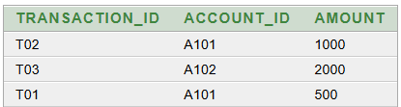
2NF--(NORMAL FORM)
The Bank Account Management System satisfies 2NF because:
The relation is already in 1NF.
Partial dependencies are removed.
Account details are separated from transaction details.
Each non-key attribute in the resulting relations depends on the complete primary key.
Account_ID uniquely identifies each account in ACCOUNT_2NF.
Transaction_ID uniquely identifies each transaction in TRANSACTION_2NF.
Data redundancy caused by partial dependencies is reduced.
AFTER 2NF
BEFORE 2NF
01-10-2026
DBMS
37

Slide 38
2NF Decomposition
ACCOUNT_2NF
ACCOUNT(
Account_ID,
Customer_ID,
Customer_Name,
Account_Type,
Branch_ID,
Branch_Name,
Loan_ID,
Loan_Amount
)
PRIMARY KEY (Account_ID)
TRANSACTION_2NF
TRANSACTION(
Transaction_ID,
Account_ID,
Amount
)
PRIMARY KEY (Transaction_ID)
Redundancy / Anomalies reduced in 2NF
• Partial dependency have been removed
•Account and transaction details are maintained separately.
•Account and transaction information can be updated independently.
• Foreign keys maintain relationships between relations.
Transitive Dependencies Remaining in 2NF
Account_ID → Customer_ID → Customer_Name
Account_ID → Branch_ID → Branch_Name
Account_ID → Loan_ID → Loan_Amount
01-10-2026
DBMS
38

Slide 39



3NF(NORMAL FORM)
Functional Dependencies
Transitive Dependencies
Account_ID → Customer_ID, Account_Type, Branch_ID, Loan_ID
Customer_ID → Customer_Name
Branch_ID → Branch_Name
Loan_ID → Loan_Amount
Account_ID → Customer_ID → Customer_Name
Account_ID → Branch_ID → Branch_Name
Account_ID → Loan_ID → Loan_Amount
01-10-2026
DBMS
39

Slide 40
3NF Decomposition
CUSTOMER_3NF
CUSTOMER_3NF(Customer_ID, Customer_Name)
BRANCH_3NF
BRANCH_3NF(Branch_ID, Branch_Name)
LOAN_3NF
LOAN_3NF(Loan_ID, Loan_Amount)
ACCOUNT_3NF
ACCOUNT_3NF(Account_ID, Customer_ID, Account_Type, Branch_ID, Loan_ID)
Redundancy / Anomalies Removed in 3NF
Transitive dependencies are eliminated.
Customer information is stored separately.
Branch information is stored separately.
Loan information is stored separately.
Data redundancy is reduced.
Update anomaly is reduced.
Insertion anomaly is reduced.
Deletion anomaly is reduced.
Data consistency and integrity are improved.
01-10-2026
DBMS
40

Slide 41
CONCLUSION:
• The Bank Account Management System provides an organized and centralized way to manage banking information.
• The system manages customers, branches, bank employees, accounts, transactions, and loans efficiently.
• Primary keys, foreign keys, and constraints help maintain data accuracy and integrity.
• Normalization up to 3NF reduces data redundancy and prevents insertion, update, and deletion anomalies.
• SQL queries enable efficient storage, retrieval, and analysis of banking data.
• Overall, the system provides a reliable, consistent, and efficient database solution for bank account management.
01-10-2026
DBMS
41

Slide 42
THANK YOU

